Slide 1
Extended Kalman Filter

Slide 2
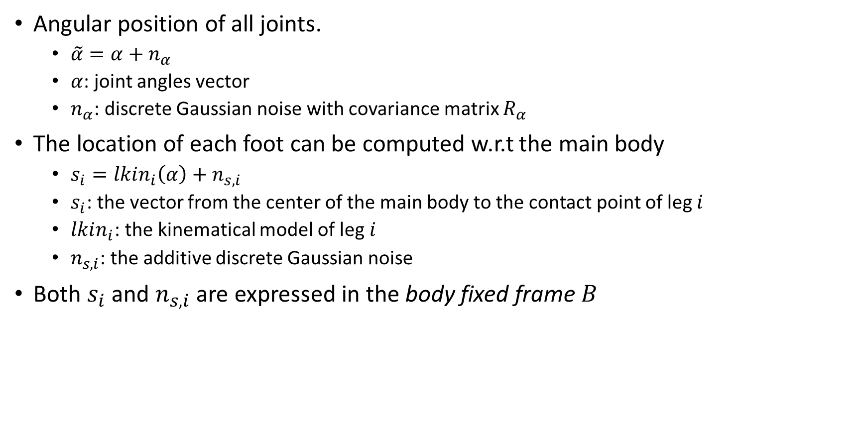
Sensor Devices and Measurement Models
Angular position of all joints.
$\tilde{α}=α+n_{α}$
$α$: joint angles vector
$n_{α}$: discrete Gaussian noise with covariance matrix $R_{α}$
The location of each foot can be computed w.r.t the main body
$s_{i}=lkin_{i}\left(α\right)+n_{s,i}$
$s_{i}$: the vector from the center of the main body to the contact point of leg $i$
$lkin_{i}$: the kinematical model of leg $i$
$n_{s,i}$: the additive discrete Gaussian noise
Both $s_{i}$ and $n_{s,i}$ are expressed in the body fixed frame $B$

Slide 3
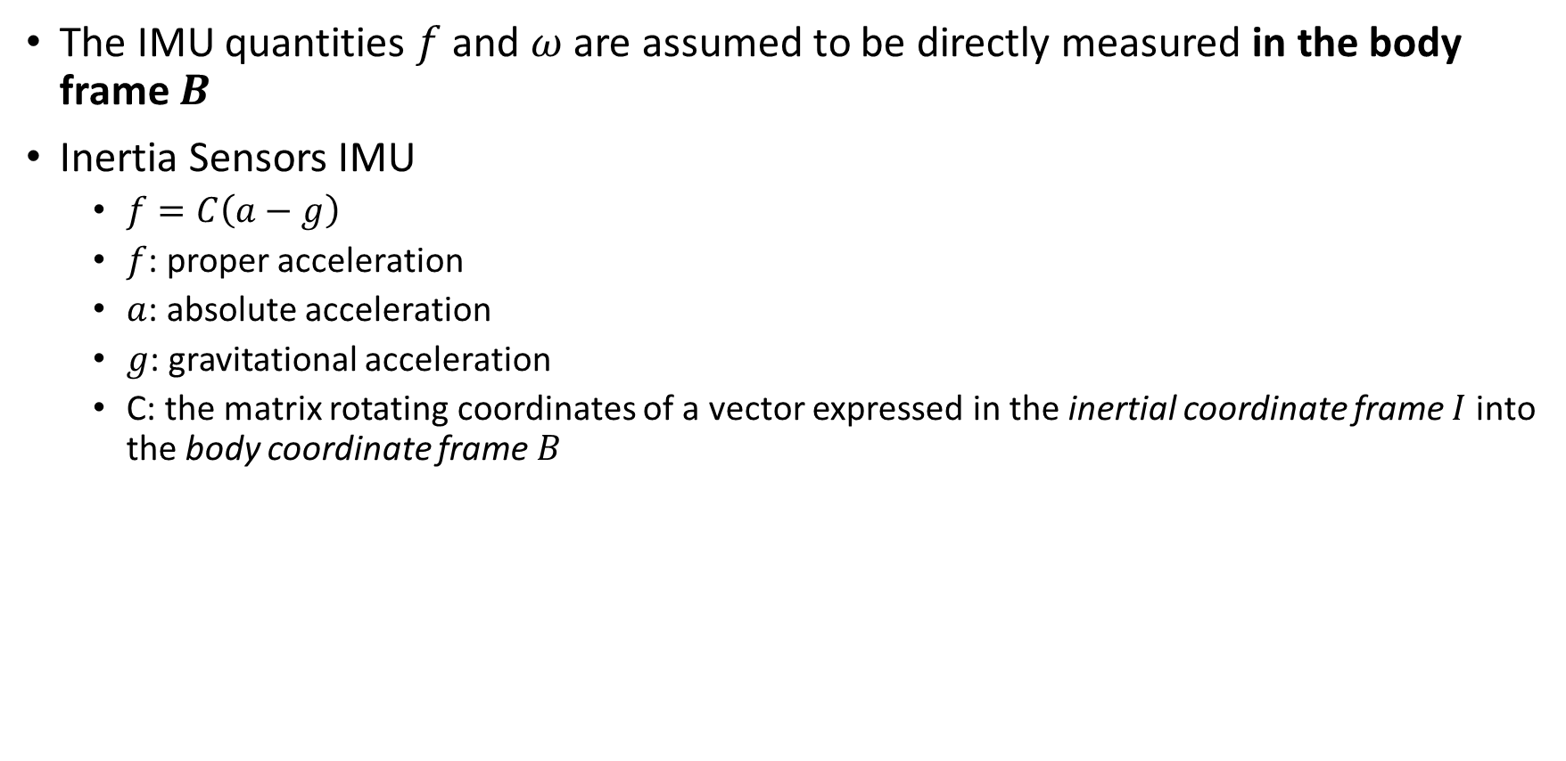
Sensor Devices and Measurement Models
The IMU quantities $f$ and $ω$ are assumed to be directly measured in the body frame $B$
Inertia Sensors IMU
$f=C\left(a−g\right)$
$f$: proper acceleration
$a$: absolute acceleration
$g$: gravitational acceleration
C: the matrix rotating coordinates of a vector expressed in the inertial coordinate frame $I$ into the body coordinate frame $B$

Slide 4
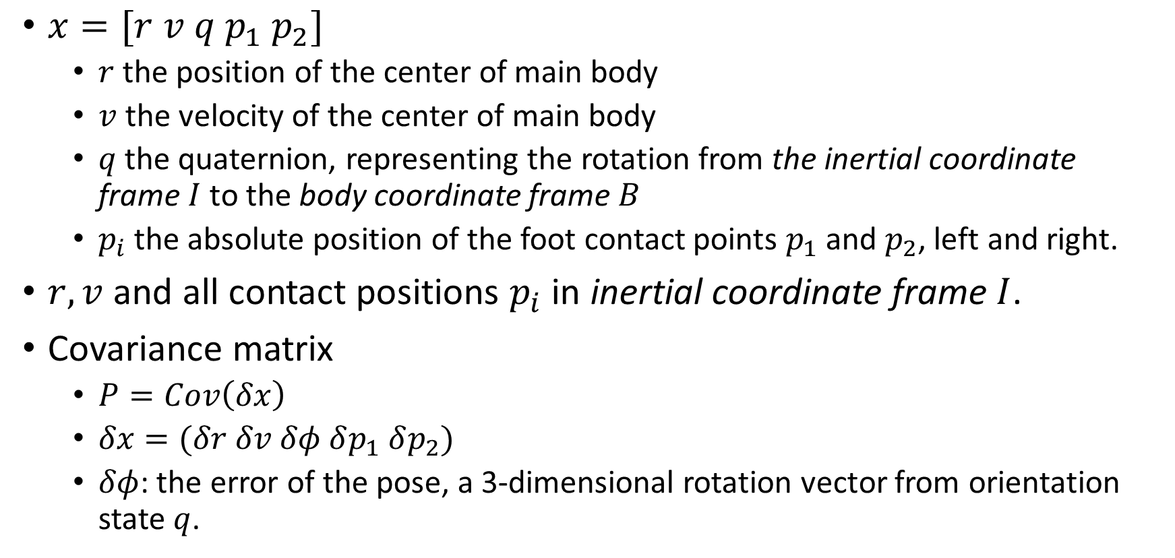
Filter State Definition
$x=[r v q p_{1} p_{2}]$
$r$ the position of the center of main body
$v$ the velocity of the center of main body
$q$ the quaternion, representing the rotation from the inertial coordinate frame $I$ to the body coordinate frame $B$
$p_{i}$ the absolute position of the foot contact points $p_{1}$ and $p_{2}$, left and right.
$r, v$ and all contact positions $p_{i}$ in inertial coordinate frame $I$.
Covariance matrix
$P=Cov\left(δx\right)$
$δx=(δr δv δφ δp_{1} δp_{2})$
$δφ$: the error of the pose, a 3-dimensional rotation vector from orientation state $q$.

Slide 5
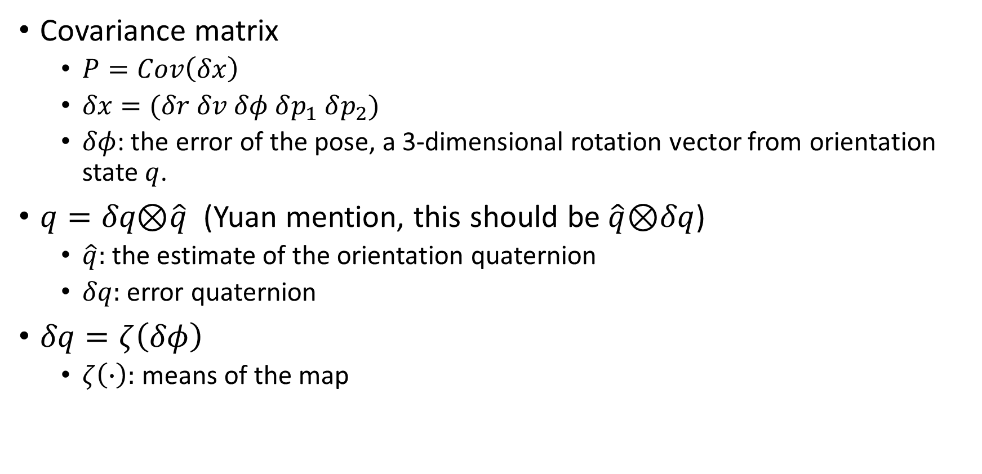
Filter State Definition
Covariance matrix
$P=Cov\left(δx\right)$
$δx=(δr δv δφ δp_{1} δp_{2})$
$δφ$: the error of the pose, a 3-dimensional rotation vector from orientation state $q$.
$q=δq\text{⊗}\hat{q}$ (Yuan mention, this should be $\hat{q}\text{⊗}δq$)
$\hat{q}:$ the estimate of the orientation quaternion
$δq:$ error quaternion
$δq=ζ\left(δφ\right)$
$ζ\left(∙\right):$ means of the map

Slide 6
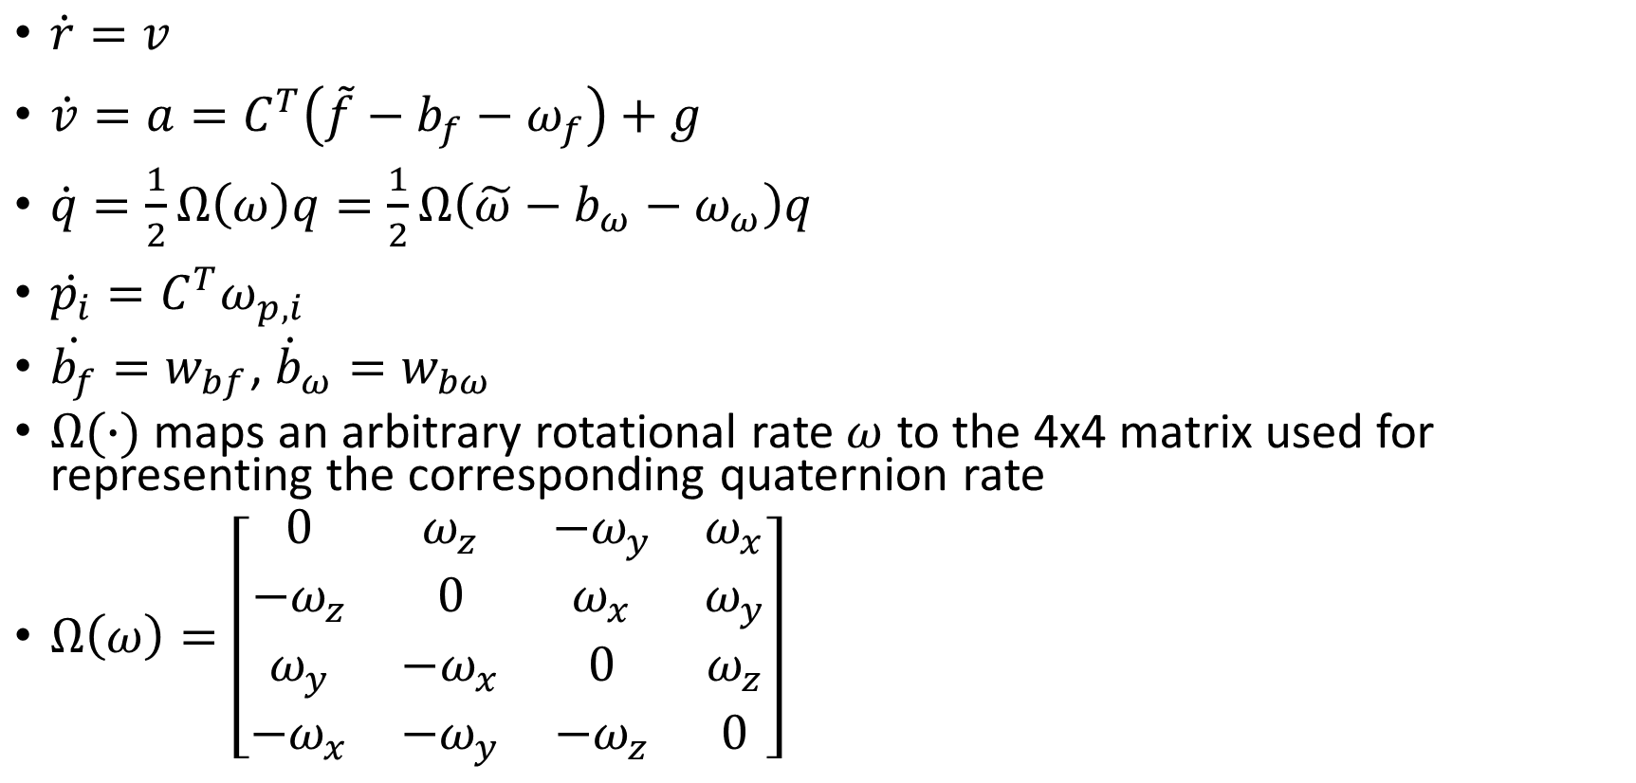
Prediction Model
$\dot{r}=v$
$\dot{v}=a=C^{T}\left(\tilde{f}−b_{f}−ω_{f}\right)+g$
$\dot{q}=\frac{1}{2}Ω\left(ω\right)q=\frac{1}{2}Ω\left(\tilde{ω}−b_{ω}−ω_{ω}\right)q$
$\dot{p_{i}}=C^{T}ω_{p,i}$
$\dot{b_{f}}=w_{bf}$, ${\dot{b}}_{ω}=w_{bω}$
$Ω(∙)$ maps an arbitrary rotational rate $ω$ to the 4x4 matrix used for representing the corresponding quaternion rate
$Ω\left(ω\right)=\left[\begin{matrix}0 & ω_{z} & −ω_{y} & ω_{x} \\ {−ω}_{z} & 0 & ω_{x} & ω_{y} \\ ω_{y} & {−ω}_{x} & 0 & ω_{z} \\ {−ω}_{x} & {−ω}_{y} & {−ω}_{z} & 0\end{matrix}\right]$

Slide 7
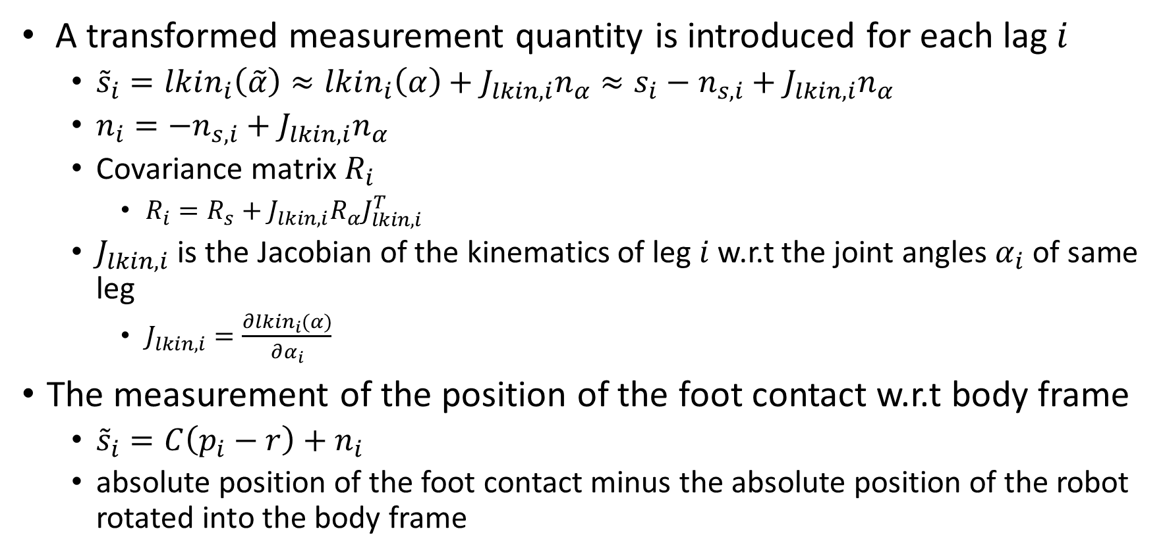
Measurement Model
A transformed measurement quantity is introduced for each lag $i$
${\tilde{s}}_{i}=lkin_{i}\left(\tilde{α}\right)≈lkin_{i}\left(α\right)+J_{lkin,i}n_{α}≈s_{i}−n_{s,i}+J_{lkin,i}n_{α}$
$n_{i}=−n_{s,i}+J_{lkin,i}n_{α}$
Covariance matrix $R_{i}$
$R_{i}=R_{s}+J_{lkin,i}R_{α}J_{lkin,i}^{T}$
$J_{lkin,i}$ is the Jacobian of the kinematics of leg $i$ w.r.t the joint angles $α_{i}$ of same leg
$J_{lkin,i}=\frac{∂lkin_{i}(α)}{∂α_{i}}$
The measurement of the position of the foot contact w.r.t body frame
${\tilde{s}}_{i}=C\left(p_{i}−r\right)+n_{i}$
absolute position of the foot contact minus the absolute position of the robot rotated into the body frame

Slide 8
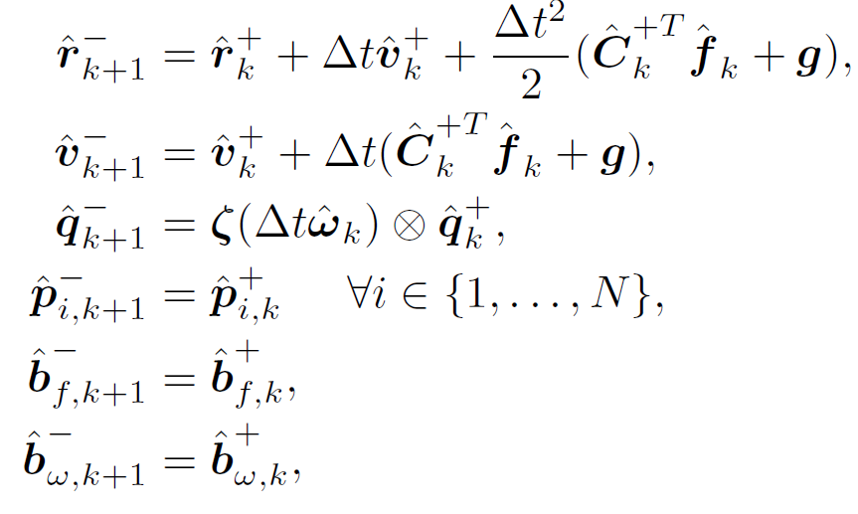

Extended Kalman Filter Equations
$Γ_{n}=\sum_{i=0}^{∞}{\frac{Δt^{i+n}}{\left(i+n\right)!}ω^{×i}}$, ${\left(∙\right)}^{×}$ represent the skew-symmetric matrix obtained from a vector
Prediction step
$\dot{r}=v$
$\dot{v}=a=C^{T}\left(\tilde{f}−b_{f}−w_{f}\right)+g$
$\dot{q}=\frac{1}{2}Ω\left(ω\right)q=\frac{1}{2}Ω\left(\tilde{ω}−b_{ω}−w_{ω}\right)q$
$\dot{p_{i}}=C^{T}w_{p,i}$
$\dot{b_{f}}=w_{bf}$
${\dot{b}}_{ω}=w_{bω}$

Slide 9

Extended Kalman Filter Equations
Prediction step
Covariance matrix propagate
$\dot{δr}=δv$
$\dot{δv}=−C^{T}f^{×}δφ−C^{T}δb_{f}−C^{T}w_{f}$
$\dot{δφ}=−ω^{×}δφ−δb_{ω}−w_{ω}$
$\dot{δp_{i}}=C^{T}w_{p,i}$
$\dot{δb_{f}}=w_{bf}$
$\dot{δb_{ω}}=w_{b}ω$

Slide 10
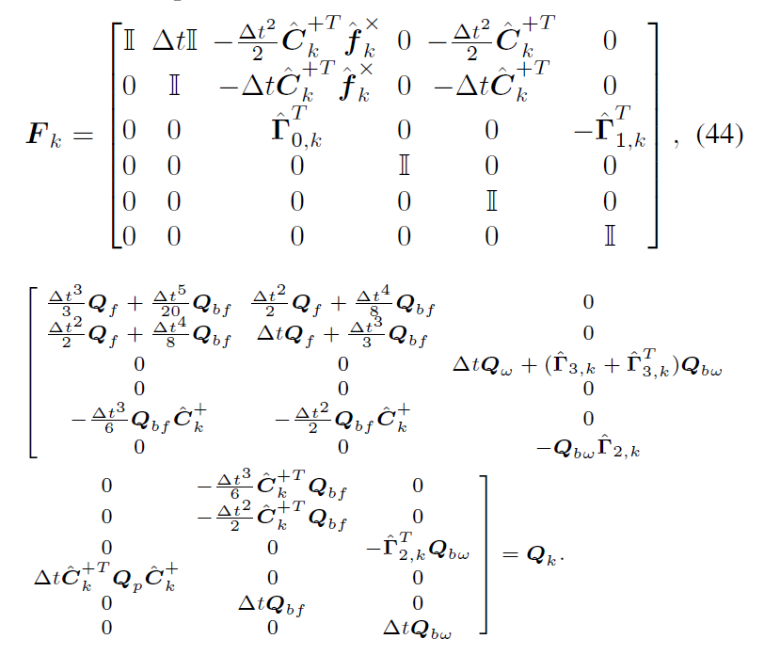

Extended Kalman Filter Equations
Prediction step
A priori estimate of the covariance matrix at timestep k+1
$P_{k+1}^{−}=F_{k}P_{k}^{+}F_{k}^{T}+Q_{k}$

Slide 11
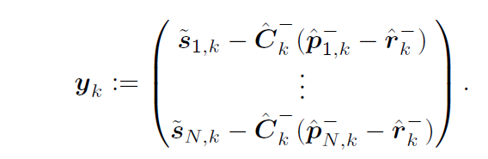
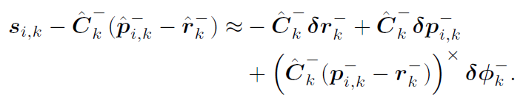
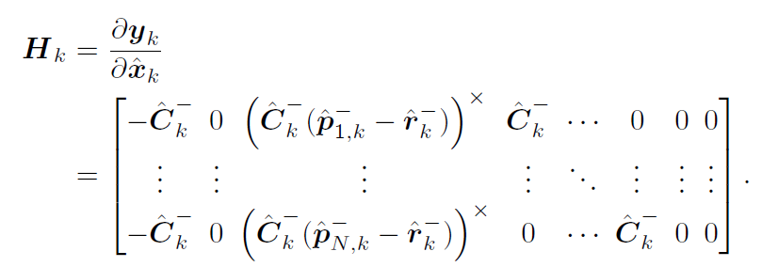
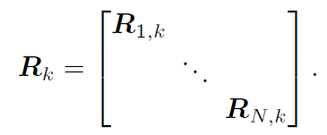
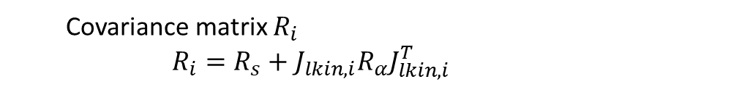

Extended Kalman Filter Equations
Update step
$S_{k}=H_{k}P_{k}^{−}H_{k}^{T}+R_{k}$
$K_{k}=P_{k}^{−}H_{k}^{T}S_{k}^{−1}$
$Δx_{k}=K_{k}y_{k}$
$P_{k}^{+}=\left(I−K_{k}H_{k}\right)P_{k}^{−}$
${\hat{q}}_{k}^{+}=ζ\left(Δφ_{k}\right)$ $\text{⊗}{\hat{q}}_{k}^{−}$
Covariance matrix $R_{i}$
$$R_{i}=R_{s}+J_{lkin,i}R_{α}J_{lkin,i}^{T}$$

Slide 12
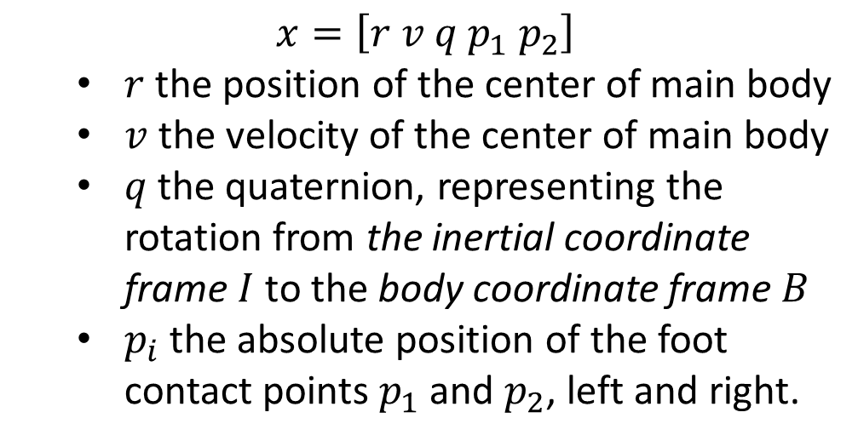
Prediction
$$x=\left[r v q p_{1} p_{2}\right]$$
$r$ the position of the center of main body
$v$ the velocity of the center of main body
$q$ the quaternion, representing the rotation from the inertial coordinate frame $I$ to the body coordinate frame $B$
$p_{i}$ the absolute position of the foot contact points $p_{1}$ and $p_{2}$, left and right.

Slide 13
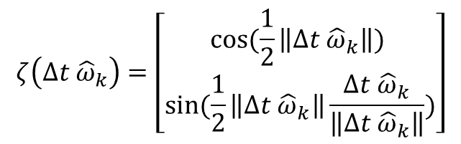

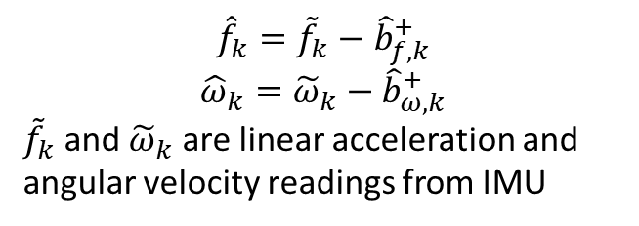
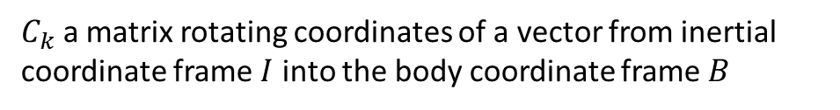
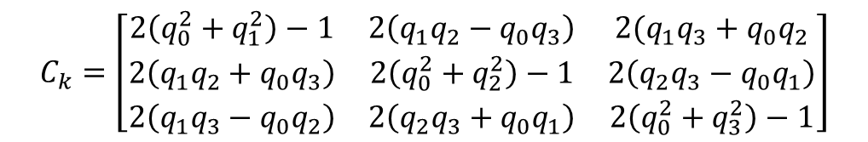



Prediction
$$ζ\left(Δt {\hat{ω}}_{k}\right)=\left[\begin{matrix}cos⁡(\frac{1}{2}\left\|Δt {\hat{ω}}_{k}\right\|) \\ sin⁡(\frac{1}{2}\left\|Δt {\hat{ω}}_{k}\right\|\frac{Δt {\hat{ω}}_{k}}{\left\|Δt {\hat{ω}}_{k}\right\|})\end{matrix}\right]$$
$$w, x, y,z$$
$${\hat{x}}_{k+1}=f({\hat{x}}_{k})$$
$$F_{k}=\frac{∂f({\hat{x}}_{k})}{∂{\hat{x}}_{k}}$$
$${\hat{f}}_{k}={\tilde{f}}_{k}−{\hat{b}}_{f,k}^{+}$$
$${\hat{ω}}_{k}={\tilde{ω}}_{k}−{\hat{b}}_{ω,k}^{+}$$
${\tilde{f}}_{k}$and ${\tilde{ω}}_{k}$ are linear acceleration and angular velocity readings from IMU
$C_{k}$ a matrix rotating coordinates of a vector from inertial coordinate frame $I$ into the body coordinate frame $B$
quaternion product $\text{⊗}$
$$n=q×r=n0+in1+jn2+kn3$$
$$C_{k}=\left[\begin{matrix}2\left(q_{0}^{2}+q_{1}^{2}\right)−1 & 2\left(q_{1}q_{2}−q_{0}q_{3}\right) & 2(q_{1}q_{3}+q_{0}q_{2} \\ 2\left(q_{1}q_{2}+q_{0}q_{3}\right) & 2\left(q_{0}^{2}+q_{2}^{2}\right)−1 & 2\left(q_{2}q_{3}−q_{0}q_{1}\right) \\ 2\left(q_{1}q_{3}−q_{0}q_{2}\right) & 2\left(q_{2}q_{3}+q_{0}q_{1}\right) & 2\left(q_{0}^{2}+q_{3}^{2}\right)−1\end{matrix}\right]$$
$$n0=\left(r0q0−r1q1−r2q2−r3q3\right)$$
$$n1=\left(r0q1+r1q0−r2q3+r3q2\right)$$
$$n2=\left(r0q2+r1q3+r2q0−r3q1\right)$$
$$n3=(r0q3−r1q2+r2q1+r3q0)$$

Slide 14


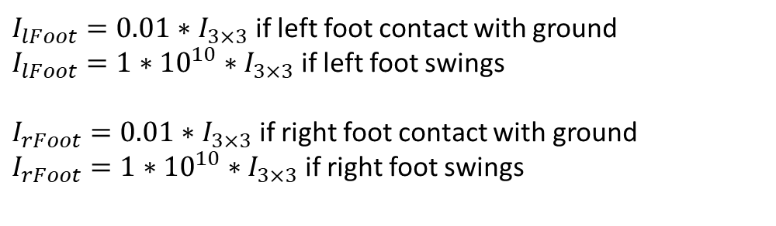
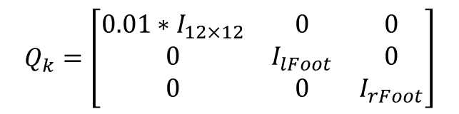

Prediction
$$P_{k+1}^{−}=F_{k}P_{k}^{+}F_{k}^{T}+Q_{k}$$
$${\hat{x}}_{k+1}=f({\hat{x}}_{k})$$
$$Q_{k}=\left[\begin{matrix}{0.01∗I}_{12×12} & 0 & 0 \\ 0 & I_{lFoot} & 0 \\ 0 & 0 & I_{rFoot}\end{matrix}\right]$$
$$F_{k}=\frac{∂f({\hat{x}}_{k})}{∂{\hat{x}}_{k}}$$
$I_{lFoot}=0.01∗I_{3×3}$ if left foot contact with ground
$I_{lFoot}=1∗{10}^{10}∗I_{3×3}$ if left foot swings
$I_{rFoot}=0.01∗I_{3×3}$ if right foot contact with ground
$I_{rFoot}=1∗{10}^{10}∗I_{3×3}$ if right foot swings

Slide 15
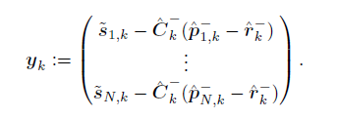
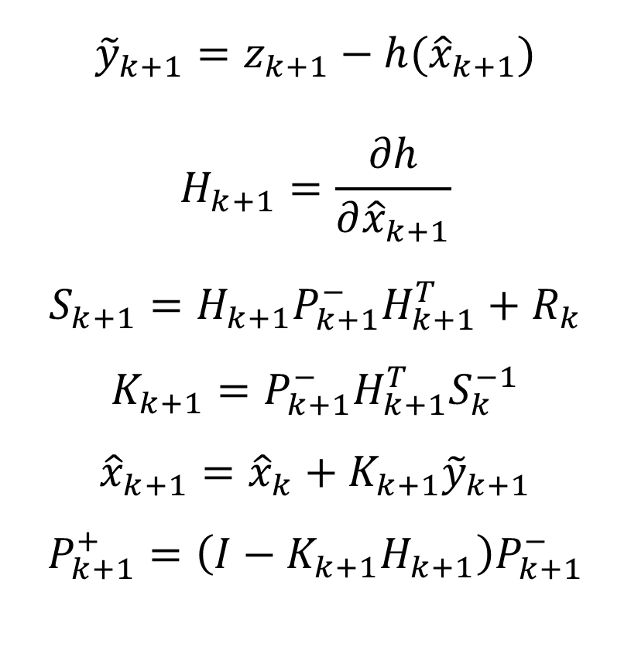
Update
$${\tilde{y}}_{k+1}=z_{k+1}−h({\hat{x}}_{k+1})$$
$$H_{k+1}=\frac{∂h}{∂{\hat{x}}_{k+1}}$$
$$S_{k+1}=H_{k+1}P_{k+1}^{−}H_{k+1}^{T}+R_{k}$$
$$K_{k+1}=P_{k+1}^{−}H_{k+1}^{T}S_{k}^{−1}$$
$${\hat{x}}_{k+1}={\hat{x}}_{k}+K_{k+1}{\tilde{y}}_{k+1}$$
$$P_{k+1}^{+}=\left(I−K_{k+1}H_{k+1}\right)P_{k+1}^{−}$$
Measurement residual

